Slide 1
Orthopedic Surgery (Hip, Knee) Re-admission Predictor | Dr. Robert Probe

Slide 2
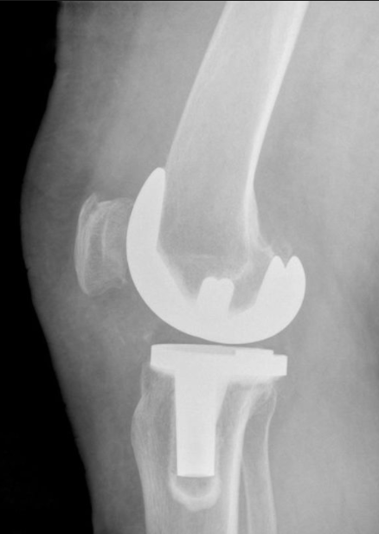
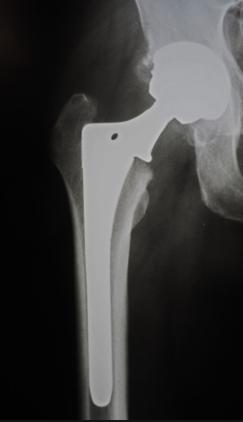
Final Project: Dr. Robert Probe
Predicting
Hospital
→ Readmissions ←
Following Joint Replacement Surgery

Slide 3
Meet... Jim & John
Jim
John
Total Hip Replacement Surgery
Total Hip Replacement Surgery
Not Readmitted
Readmitted

Slide 4
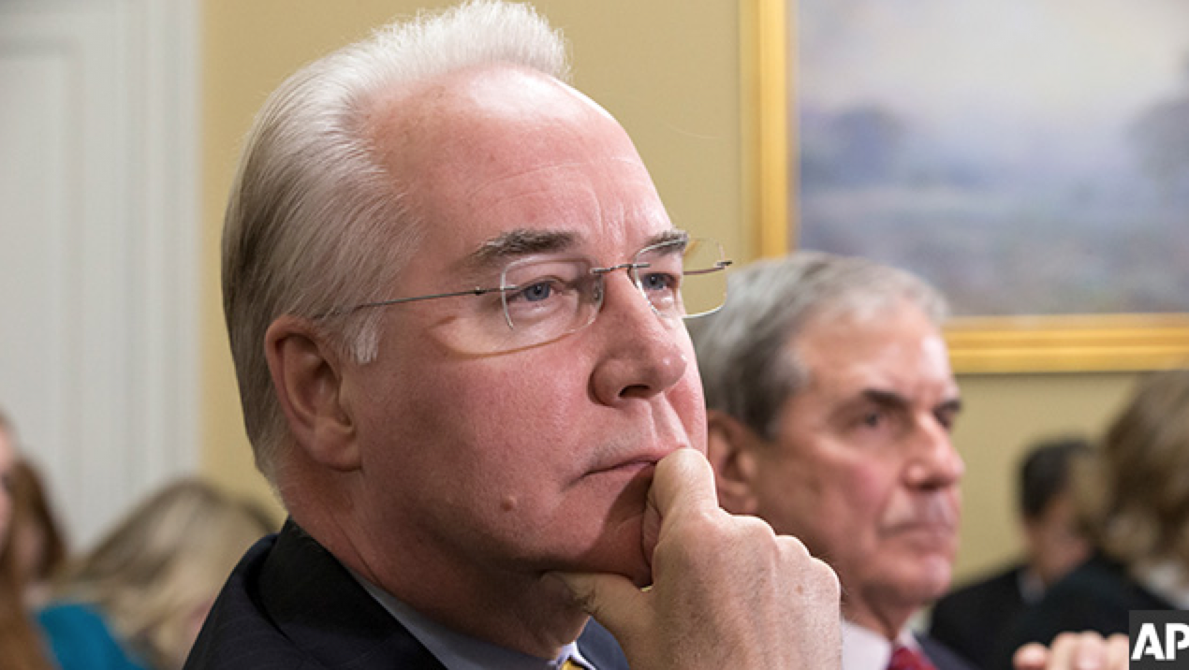
WHY... focus on Joint Replacement ???
By 80 years of age
6% will have an → artificial hip
10% will have an → artificial knee
Growth rate
Hips 7.4% CAGR
Knees 15.7% CAGR
Average cost: total knee customer
$28,184 US
$6,687 Spain
Notes:
The cost of joint replacement in the United States is the largest single cost to the Medicare program
Projections of growth in this expenditure are staggering with……..

Slide 5
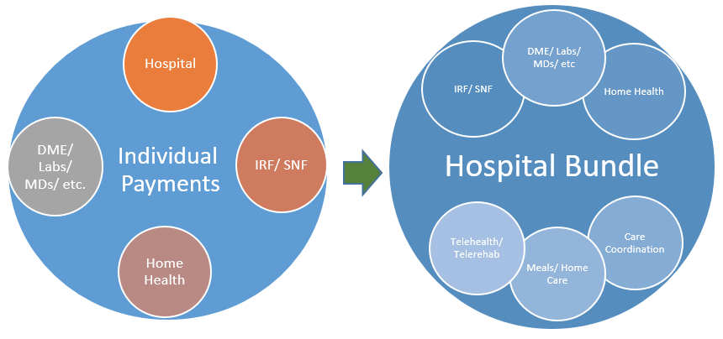
Evolution of Medicare Payments
Medicare created.........................1965
Inpatient prospective payment............1984
DRG (diagnosis related groups)
MS-DRGs
APR-DRGs
Optional Bundled Payment....................2013
Pilot Mandatory Bundled Payment.....................2016
Notes:
A brief history in the way the Center for Medicare Services pays for services is relevant.

Slide 6
Bundles: Reimbursement Future?
Bundled Payment for Care Improvement (BPCI)
Volunteer Program Started in October 2013
48 Episode Types Made Up Of DRG “Families”
Account for 70% of Total Medicare Spend
Most Volunteered for by Participants - Major Joint Replacement, Congestive Heart Failure, Simple Pneumonia, COPD & Sepsis
Joints (CJR) First BPCI to be Mandated
Hospitals held responsible for Costs and Quality for lower extremity joint replacement (LEJR) procedures – DRGs 469 & 470 – includes fractures
Costs: All Part A and B costs of care during stay plus Medicare costs for surgery plus 90 days post hospital discharge w/very few exclusions
Quality: RSCR, HCAHPS & Patient Reported Outcomes (PRO)
Average Cost of Each Readmission:
→ $19,000 ABOVE... (Original $28,184 Care)
Notes:
In 2013 a voluntary bundled payment system was introduced.
Because of the successes in these pilots, a mandatory trial was prescribed for 70 MSAs across the US.

Slide 7
Back to... Jim & John
Jim
65 years old
3 Days in Hospital post-op
John
Total Hip Replacement Surgery
3 Days in Hospital post-op
Total Hip Replacement Surgery
65 years old
Not Readmitted
Readmitted
Home Health
Home Health
SAME: Procedure
SAME: Age
SAME: Length of Stay
SAME: Discharge Type
?
DIFFERENT OUTCOME
SO THEN...
WHYdoes John
readmit and Jim doesn’t

Slide 8
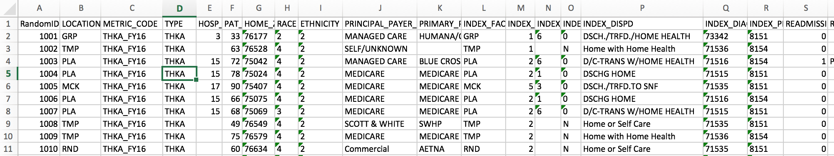
The Data
July 2014 – June 2016 (2 years)
7192 hip and knee replacements
341 Readmissions
Variable
Age, Race, Ethnicity, Payment Type, Discharge Date, Length of Stay, Discharge Instructions, Hospital System, and MORE.

Slide 9
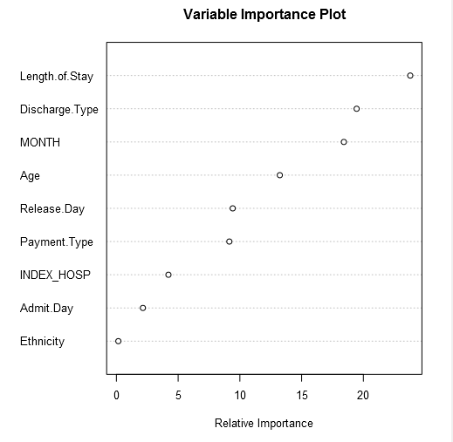
Expand the dataset
Boosted model ran to determine key variables in dataset
Expected importance:
Length of Stay
Discharge Type
Age
Unexpected
Release Month
Release Day of Week
Payment Type
Notes:
Ran all data through BOOSTED Model

Slide 10
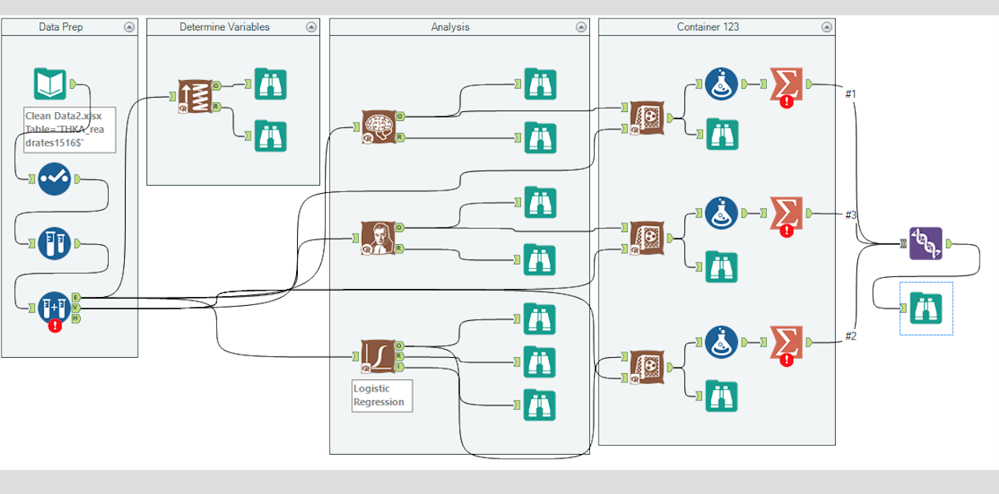
Alteryx Model

Slide 11
Test Batch Results
Logistic Regression
Naïve Bayes
Neural Network
→ (Most False Positives X )
 | Suc-Obs | Fail-Obs
Suc-Pred | 171 | 299 | 470
Fail-Pred | 101 | 565 | 666
 | 272 | 864 | 1136
Accuracy | 62.87% | 65.39% | 64.79%
 | Suc-Obs | Fail-Obs
Suc-Pred | 33 | 50 | 83
Fail-Pred | 239 | 814 | 1053
 | 272 | 864 | 1136
Accuracy | 12.13% | 94.21% | 74.56%
→ (Most Accurate!!!)
 | Suc-Obs | Fail-Obs
Suc-Pred | 86 | 43 | 129
Fail-Pred | 186 | 821 | 1007
 | 272 | 864 | 1136
Accuracy | 31.62% | 95.02% | 79.84%
Notes:
SCORING DATA from all 3 :
Neural Network = Best model = OVEALL ACCURACY = subjects least amount of patients to procedures who did not need them AND because 67% of time model predicts .....patient actually benefitted from the procedure!
Logistic Reg has 36% chance of positive prediction being TRUE
40%
67%
LR = Most “false positives”

Slide 12
Sensitivity, Specificity and Predictive Value
 | Logistic Regression | Naïve Bayes | Neural Network
True Positive | 171 | 33 | 86
False Negative | 101 | 239 | 186
False Positive | 299 | 50 | 43
True Negative | 565 | 814 | 821
Sensitivity | 62.87% | 12.13% | 31.62%
Specificity | 65.39% | 94.21% | 95.02%
Positive Predictive Value | 36.38% | 39.76% | 66.67%
Sensitivity – The ability to determine the MAXIMUM number of POSITIVES
Specificity – The ability to determine the MAXIMUM number of NEGATIVES
Predictive Value - How accurate is the POSITIVE prediction

Slide 13
Back to..... Jim & John
Score
.7104
Score
.3572
Jim (Not Readmitted)
John (readmitted)
August Surgery
May Surgery
Released on Sunday
Released on Thursday
Hospital = TMP
Hospital = WAX
Not Hispanic
Not Hispanic
Medicare
Medicare
Neural Network Predicts NEGATIVE Readmission
Neural Network Predicts POSITIVE Readmission
Notes:
WE suspect that Month and Day of Relase may be related to Support Structure might be consideration for why this occurs
WE’ve (THE MODEL) has now determined......................WE NEED to do something for John

Slide 14
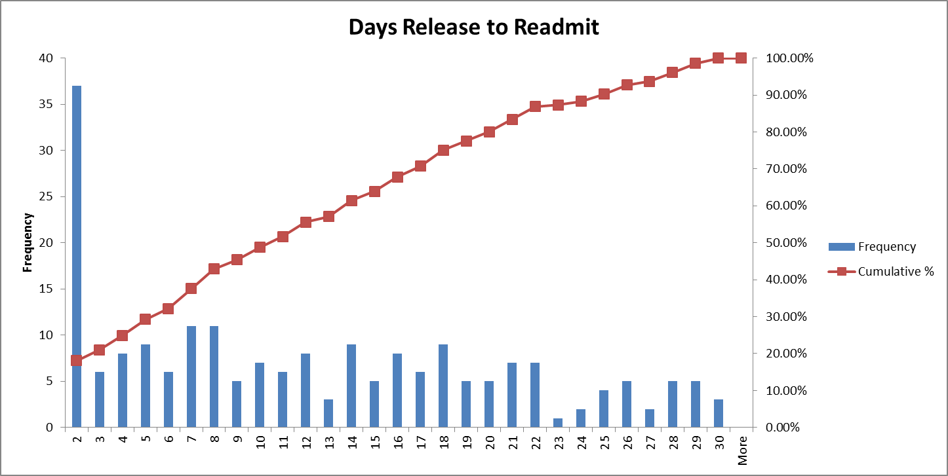
Histogram of Data Set
→ 18.05% of dataset readmitted within 2 days of release from hospital ←
Estimated cost of each readmission: $19,000
Notes:
18 % Readmitted with 2 days
24% Readmitted with

Slide 15

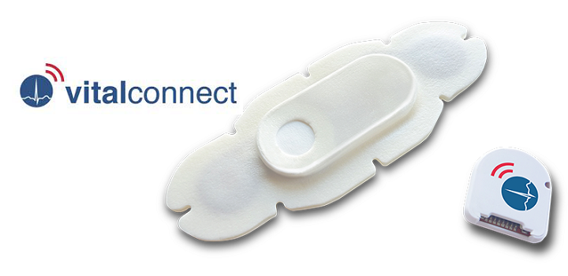
2 Prong Medical Intervention:
Day 1 “WEARABLE”VITALS
* Temperature
* Respiratory Rate
* SPO2
* Posture
DAILY RECORDINGS
DIGITALLY DELIVERED
* HR
* Steps
Day 3-4
Internal Medicine Doctor Visit
Notes:
RE-ITEREATE: AS YOU MAY RECALL - 18% of patients are typically readmitted with 48hrs
*** WEARABLES addresss this both sets of vulnernable populations
1st – 18% readmitted within 1st 2 days - make sure they don’t readmit before they get to the doctro
re a “Bridge” to make sure they don’t readmit prior to the Dr. visit***
Warning: 24% RE-ADMIT before 96-hours
** EVERyperson that the Neural network predicted would readmit.....would be sent home with a wearable
Additonally ,
Soooooo....make sure wearables are “IN PLACE” as a slient alarm for Drs. To be aware they need to escalate their readmission

Slide 16
ECONOMICS
[1] Preventative Cost Measures /Patient
$100 Monitoring System [+]
$250 Dr. Visit
x81 Patients with high risk
→$28,350 / annual cost←
[2] To Prevent 54 Readmissions saving
$ 19,000 / Patient
TOTAL SAVINGS →$513 K
NET SAVINGS $484,650 / Year
→ Assuming a 50% success rate for preventative measures ←
Notes:
Because 18% are readmitted within 2 days.... They are all going home with a wearable monitor
The monitoring system will help catch patients during the very “vulnerable” post discharge release
24.86% sample population readmitted within 96 hours.......
Based off the findings of the neural model,
54 readmissions of the 81 patient would have been prevented
And ultimately ...>BETTER SERVING THE PATIENT

